Slide 1
From Rural Farmers’ Policy Preferences to Urban Consumers’ Food Choices: Exploring Kenyan AgriFood System Challenges through Diverse Approaches and Methods
Mywish K. Maredia
Michigan State University
Research Seminar at:
Department of Agricultural Economics, University of Nairobi
October 31, 2024

Slide 2
Let’s first explore the topic of Consumer Food Choices

Slide 3



Unpacking the Impact of Food Environments on Food Choices and Diet Quality in Urban and Peri-Urban Kenya
Mywish K. Maredia, Timothy Njagi, David Tschirley, Ayala Wineman, Aisha Sophia Otwoma, Nahian Bin Khaled, Ian Fisher, Lilian Kirimi, Thomas Reardon, Hillary Bii, Michael Asiago, Semeni Ngozi, and Thomas Mgonja
Image generated by OpenAI DALL·E (April 8, 2024)

Slide 4
Context
  Food system transformation
  → Changing diets
    Diets are changing across urban and rural food systems (Reardon et al., 2021; Popkin, Corvalana, and Brumer-Strawn, 2020; Tschirley et al., 2015)
    Drivers of change include
        ➢ Urbanization (Kelly, 2016) ➢ Food cultures (Pingali, 2007)
        ➢ Incomes (Popkin et al. 2012) ➢ Health/environment concerns
  Changing mix of nutritional problems
    Diet related NCDs co-exist with under-nutrition (Popkin 2006; Rousham et al. 2020; Laar et al. 2022)
    Hidden hunger (micro-nutrient deficiencies) – remains a significant public health issue
Notes:
Growing body of literature on food environments: What is available in a given space, how consumers make their food choices, and how this results in healthy or unhealthy diets.
Focus on home food environments
But people make food choices both at home & away from home.
Urban consumers are more likely to eat away from home than rural consumers.
Away from home environments, e.g., work and transit food environments.
Document the complexities involved in precise estimation of food consumption.
This study will inform nutrition policies that aim to improve access to healthier foods and/or reduce access to unhealthy foods—in other words, to shape the food environments that influence food decisions.
Pingali, P. (2007). Westernization of Asian diets and the transformation of food systems:
Implications for research and policy. Food Policy, 32(3), 281–298.
Popkin, B. M. (2006). Global nutrition dynamics: The world is shifting rapidly toward a diet
linked with noncommunicable diseases. American Journal of Clinical Nutrition, 84(2),
289–298.
Popkin, B. M., Adair, L. S., & Ng, S. W. (2012). Global nutrition transition and the pandemic of
obesity in developing countries. Nutrition Reviews, 70(1), 3–21.
The Nutrition Transition in Developing Asia: Dietary Change,
Drivers and Health Impacts . . . . . . . . . . . . . . . . . . . . . . . . . . . . . . . . . . . . 83
Matthew Kelly

Slide 5
Context (cont’d)
Nutrition Indicators for Kenya (2022) | %
Children (0-59 Months)
Stunted | 17.6
Underweight | 10.1
Wasted | 4.9
Women (15-49 years)
Iron deficiency | 26.0
Anemic | 42.6
Population
Undernourished | 26.9
Obese or overweight | 31.8
Under-nutrition is declining but remains alarmingly high
The nature of the problem is changing
Strategies to fight malnutrition have to be adjusted
Focus on diets has become more critical due to these factors
Source: KDHS, 2022
Notes:
Growing body of literature on food environments: What is available in a given space, how consumers make their food choices, and how this results in healthy or unhealthy diets.
Focus on home food environments
But people make food choices both at home & away from home.
Urban consumers are more likely to eat away from home than rural consumers.
Away from home environments, e.g., work and transit food environments.
Document the complexities involved in precise estimation of food consumption.
This study will inform nutrition policies that aim to improve access to healthier foods and/or reduce access to unhealthy foods—in other words, to shape the food environments that influence food decisions.
Pingali, P. (2007). Westernization of Asian diets and the transformation of food systems:
Implications for research and policy. Food Policy, 32(3), 281–298.
Popkin, B. M. (2006). Global nutrition dynamics: The world is shifting rapidly toward a diet
linked with noncommunicable diseases. American Journal of Clinical Nutrition, 84(2),
289–298.
Popkin, B. M., Adair, L. S., & Ng, S. W. (2012). Global nutrition transition and the pandemic of
obesity in developing countries. Nutrition Reviews, 70(1), 3–21.
The Nutrition Transition in Developing Asia: Dietary Change,
Drivers and Health Impacts . . . . . . . . . . . . . . . . . . . . . . . . . . . . . . . . . . . . 83
Matthew Kelly

Slide 6
Current literature
Emerging research examines the impact of food environments (FEs) on dietary and nutritional outcomes
Food environments refer to “the physical, economic, and sociocultural settings that influence dietary behaviors”
Studies link the availability and type of food in various settings (e.g., homes, workplaces) to diet quality metrics (Bromage et al. 2021; Trijsburg et al. (2019))
Research explores how access to nutritious food vs. high-calorie "junk food" influences health outcomes and diet quality
The evidence remains mixed, with contradictory findings fueling debate about the strength of the link between FEs and diet quality (Glass and Bilal 2016; Cooksey-Stowers, Schwartz, and Brownell 2017; Cobb et al. 2015; Ambikapathi et al. 2021)

Slide 7
Limitations of existing literature
Primary focus has been on residential areas, limiting the understanding of broader consumption patterns (Ambikapathi et al. 2021; Busse et al. 2023; Downs et al. 2022; Laska et al. 2010; Tschirley et al. 2022)
FE quality is often measured by outlet density or proximity (Duran et al. 2016; Spence et al. 2009)
  Results on health impacts are mixed and incomplete, especially in developing countries
Metrics like shelf space and location of food outlets have high predictive power, but these measures are limited in low-income countries (Turner et al. 2020; Tschirley et al. 2022)
Traditional research in Africa emphasizes household data, neglecting individual behaviors like snacking and eating outside the home, which are becoming more important with urbanization (Russell et al. 2018; Rousham et al. 2020)

Slide 8
Contribution of this study
Focus on individual-level diet quality
  Interviewed multiple individuals within households
  Systematically captured all meals, snacks, and food procurement methods
Collected commuting data and geographic routes and destination to evaluate the influence of both the quality of FEs in the vicinity of an individual’s home (“home FE”) as well as in the vicinity of their commuting destination (“work FE”)
Quantification of retail shelf space and food services is provided, addressing recent calls for more precise FE measures

Slide 9

The study aims to offer new insights into the relationship between food environments and diet quality in dynamic urban contexts in Africa
Research questions
  What are the food choices of consumers in urban and peri-urban Nairobi and Kisumu?
  What is the role of the “food environment” in influencing these food choices?
Image generated by OpenAI DALL·E (February 3, 2024)

Slide 10
Outline
1. Diet quality
2. Food environments
3. Influence of Food environments on diet quality
What we did and what we found (descriptive results)

Slide 11

1. Diet Quality

Slide 12
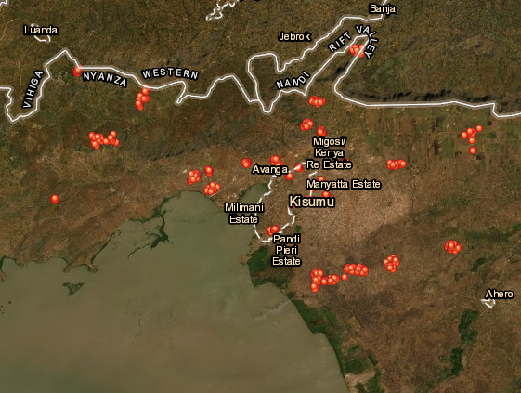
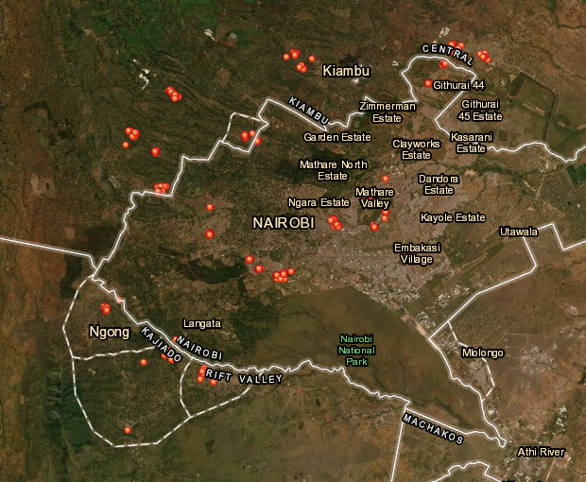
Diets: Data
Household surveys (1507 HHs), conducted in 2022
  Urban and peri-urban areas of Nairobi and Kisumu, Kenya (multi-stage stratified sampling to get representative consumers and their home FEs)
Kisumu
Nairobi

Slide 13
Diets: Share of calories (average per day)
22% of calories, on average, from the out-of-home food economy.

Slide 14

Diets: Global Diet Quality Score (GDQS)
The Global Diet Quality Score (GDQS) was developed to serve as a universally applicable method for measuring diet quality (Bromage et al. 2021).
  Prior to the GDQS, no diet quality metric addressed the double burden of malnutrition.
  Both foods that are healthy and unhealthy are included in the GDQS.
The GDQS is constructed by assigning points based on the grams consumed in each of 25 food categories.
  For healthy food groups, more consumed = more points.
  For unhealthy food groups, less consumed = more points.
  For foods that are unhealthy in excess, the points increase then decrease with quantity consumed.

Slide 15
Grams consumed of each category per day (mean values)
Refined grains and baked goods (unhealthy) have the highest consumption, followed by high-fat dairy (excessive) and whole grains (healthy)
Average daily intake: 53.3g of sweets and 47.3g of deep-fried foods.
Dark green leafy vegetables are commonly consumed.
Healthy options like deep orange tubers and vegetables are rarely eaten.

Slide 16
Diets: Global Diet Quality Score (GDQS)
About 11% of adults are at high risk, and 82% are at moderate risk, of diet-related non-communicable diseases
The GDQS ranges in value from 0 to 49, with a score of 0–15 indicating high risk of diet-related NCDs, 15–23 indicating moderate risk, and 23–49 indicating low risk. Individual-level values calculated by averaging over multiple days.

Slide 17
Diets: GDQS + (healthy) and GDQS- (unhealthy), by age

Slide 18
Key takeaways for diet quality
Limited dietary diversity
Heavy emphasis on grains.
Although dark green leafy veg are prominent, many categories of fruits and vegetables see little consumption.
Considerable consumption of refined grains/baked goods, purchased deep fried foods, and sweets.
  A lot of sugar is consumed in the form of sugared tea (chai).

Slide 19
Key takeaways for diet quality (cont’d)
Importance of out-of-home food economy
  On average, 22% of calories (mostly as FAFH or takeout)
  For some subpopulations (e.g., men, commuters), this is higher
Risk of diet-related NCDs
  About 11% of adults are at high risk, and 82% are at moderate risk
Strong correlation between age and healthiness of diets

Slide 20
2. Food Environments: Characteristics
Image generated by OpenAI DALL·E (April 8, 2024)

Slide 21

Food environments: Definition and Data
Home FE: 0.4 km (or 0.6 km in PU-Kisumu) radius around each sampled enumeration area (n=61)
Work FE: 0.4 km (or 0.6 km in PU-Kisumu) radius around the work location
EA 1
Home FE
Work-FE

Slide 22
Food environments: Definition and Data
Home FE: 0.4 km (or 0.6 km in PU-Kisumu) radius around each sampled enumeration area (n=61)
Work FE: 0.4 km (or 0.6 km in PU-Kisumu) radius around the work location
Census of food outlets in each food environment (FE), taking account of what they sell
Sample of non-prepared food outlets in each FE for measurement of shelf space
EA 1
Home FE
Work-FE

Slide 23
Food Environment Data: What’s Novel?
In evaluating the drivers of diet quality, we considered the quality of FEs in the vicinity of home (“home FE”) as well as in the vicinity of commuting destination (“work FE”).
Rigorous measures of FE characteristics were collected (or developed). Information was inclusive of retail shelf space and food service product offers.

Slide 24
Home Food environments: Shelf space (m³/km²)
In absolute terms, shelf space for both healthy and unhealthy foods is highest in Nairobi-urban.
Significantly more shelf space is devoted to unhealthy foods than healthy foods across all types of FEs.

Slide 25
Food Environment: % shelf space allocated to unhealthy foods
Shelf space devoted to unhealthy foods is proportionately higher in areas with a higher probability of poverty, compared to those with a lower probability of poverty
Also, shelf space devoted to unhealthy foods is relatively higher in peri-urban areas compared to urban

Slide 26
Home FE: Prices of healthy and unhealthy foods
On a per-gram basis, healthy foods are more expensive than unhealthy foods.
Healthy foods are relatively more expensive in peri-urban Nairobi and areas with higher probability of poverty.

Slide 27
Characteristics of home and work FEs experienced by commuters
Home environments have a higher density of healthy food sites
Work environments offer more shelf space for both healthy & unhealthy foods
There is a greater diversity of both healthy and unhealthy foods at work
Healthy foods are significantly more expensive at work compared to home
﻿ | Home FE | Work FE
Density of healthy food offer sites (No./km²) | 1,028.0 | 864.9
Density of unhealthy food offer sites (No./km²) | 606.8 | 618.3
Shelf space for healthy foods (m³) | 27.2 | 35.8
Shelf space for unhealthy foods (m³) | 44.7 | 56.9
% Shelf space allocated to healthy foods | 35.8 | 35.9
Diversity of healthy foods | 80.7 | 87.0
Diversity of unhealthy foods | 70.5 | 79.6
Average price healthy foods (KES/gram) | 5.5 | 10.2
Average price unhealthy foods (KES/gram) | 2.3 | 2.4
Average ratio of prices (healthy:unhealthy) | 9.2 | 13.1
Observations | 1,172 | 1,172

Slide 28
Key takeaways for food environments
There is considerable variability over space in terms of:
  How much food is available in the vicinity of home
  Share of shelf space taken up by healthy versus unhealthy foods
  Density of healthy versus unhealthy foods [(outlets x food categories)/km²]
  Prices of healthy versus unhealthy foods
There are also commonalities. Across all types of food environments (neighborhoods):
  More shelf space is devoted to unhealthy foods than healthy foods
  More diversity of healthy than unhealthy foods
  Healthy foods are more expensive on a per-gram basis
Home and work FEs are different on some characteristics (e.g., number and diversity of healthy vs. unhealthy foods, and prices) that could plausibly influence dietary behaviors differently at home and work

Slide 29

3. Influence of food environments on diets

Slide 30
Method and Research Questions
We did regression analysis:
Q1: Does the quality of the home FE explain diet quality?
Q2: Does the quality of the FE to which a person is exposed each day (depending on where they spend their time) explain the day-to-day variation in their day-level diet quality (controlling for individual fixed effects)?

Slide 31
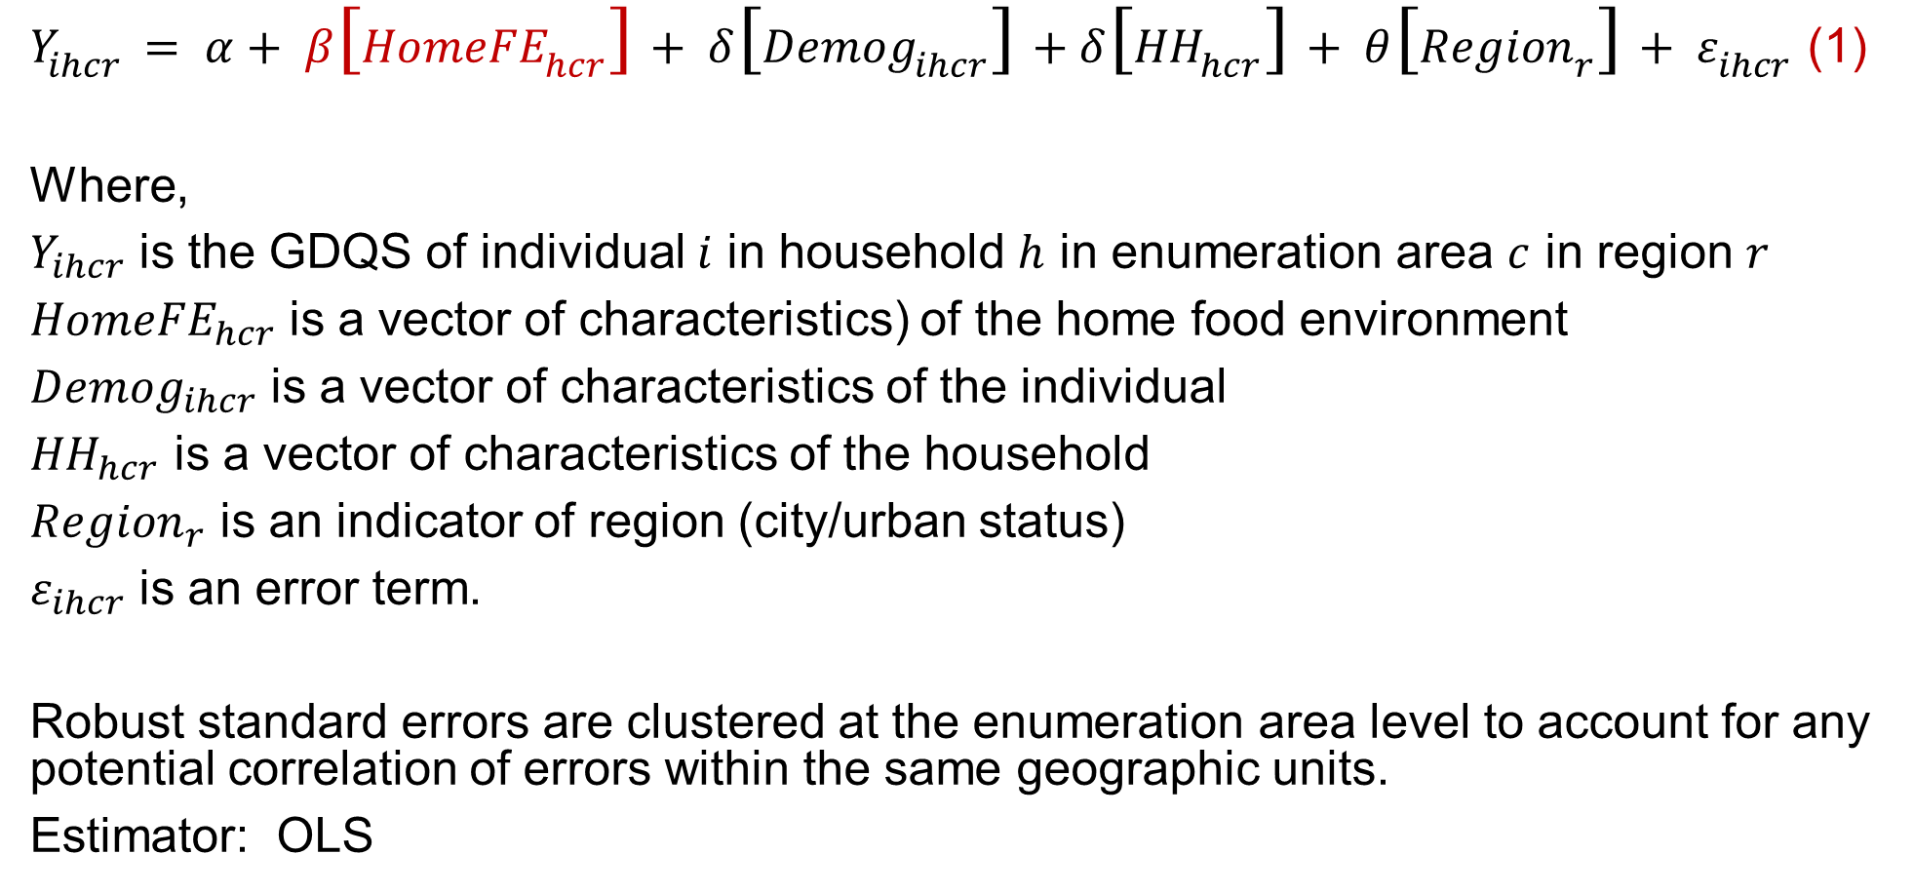
Regression model (Q1)
$Y_{ihcr}= α+ β\left[{HomeFE}_{hcr}\right]+ δ\left[{Demog}_{ihcr}\right]+δ\left[{HH}_{hcr}\right]+ θ\left[{Region}_{r}\right]+ ε_{ihcr}$ (1)
Where,
$Y_{ihcr}$ is the GDQS of individual $i$ in household $h$ in enumeration area $c$ in region $r$
${HomeFE}_{hcr}$ is a vector of characteristics) of the home food environment
${Demog}_{ihcr}$ is a vector of characteristics of the individual
${HH}_{hcr}$ is a vector of characteristics of the household
${Region}_{r}$ is an indicator of region (city/urban status)
$ε_{ihcr}$ is an error term.
Robust standard errors are clustered at the enumeration area level to account for any potential correlation of errors within the same geographic units.
Estimator: OLS

Slide 32
 | (1) | (2) | (3) | (4)
 | Dependent variable: Average GDQS
Number of healthy food offer sites per km² | 0.003***
 | (0.001)
Number of unhealthy food offer sites per km² | -0.005***
 | (0.001)
Shelf space devoted to healthy foods (100s m³/km²) |  | -0.021
 |  | (0.419)
Shelf space devoted to unhealthy foods (100s m³/km²) |  | -0.002
 |  | (0.234)
% shelf space in home FE that is healthy |  |  | -0.004
 |  |  | (0.009)
Measure of diversity of healthy foods in home FE |  |  |  | 0.033***
 |  |  |  | (0.012)
Measure of diversity of unhealthy foods in home FE |  |  |  | -0.004
 |  |  |  | (0.007)
Average price of healthy foods (KES/gram) | 0.011 | 0.005 | 0.004 | 0.006
 | (0.009) | (0.011) | (0.011) | (0.010)
Average price of unhealthy foods (KES/gram) | -0.004 | 0.002 | 0.003 | 0.002
 | (0.014) | (0.015) | (0.015) | (0.017)
All controls | Yes | Yes | Yes | Yes
Observations | 2,150 | 2,150 | 2,150 | 2,150
R-squared | 0.071 | 0.053 | 0.053 | 0.060
Healthy food density positively impacts diet quality; while unhealthy food density negatively affects it
Diversity of healthy foods in the home food environment has a positive effect on GDQS
The diversity of unhealthy foods and shelf space for both do not show significant effects

Slide 33
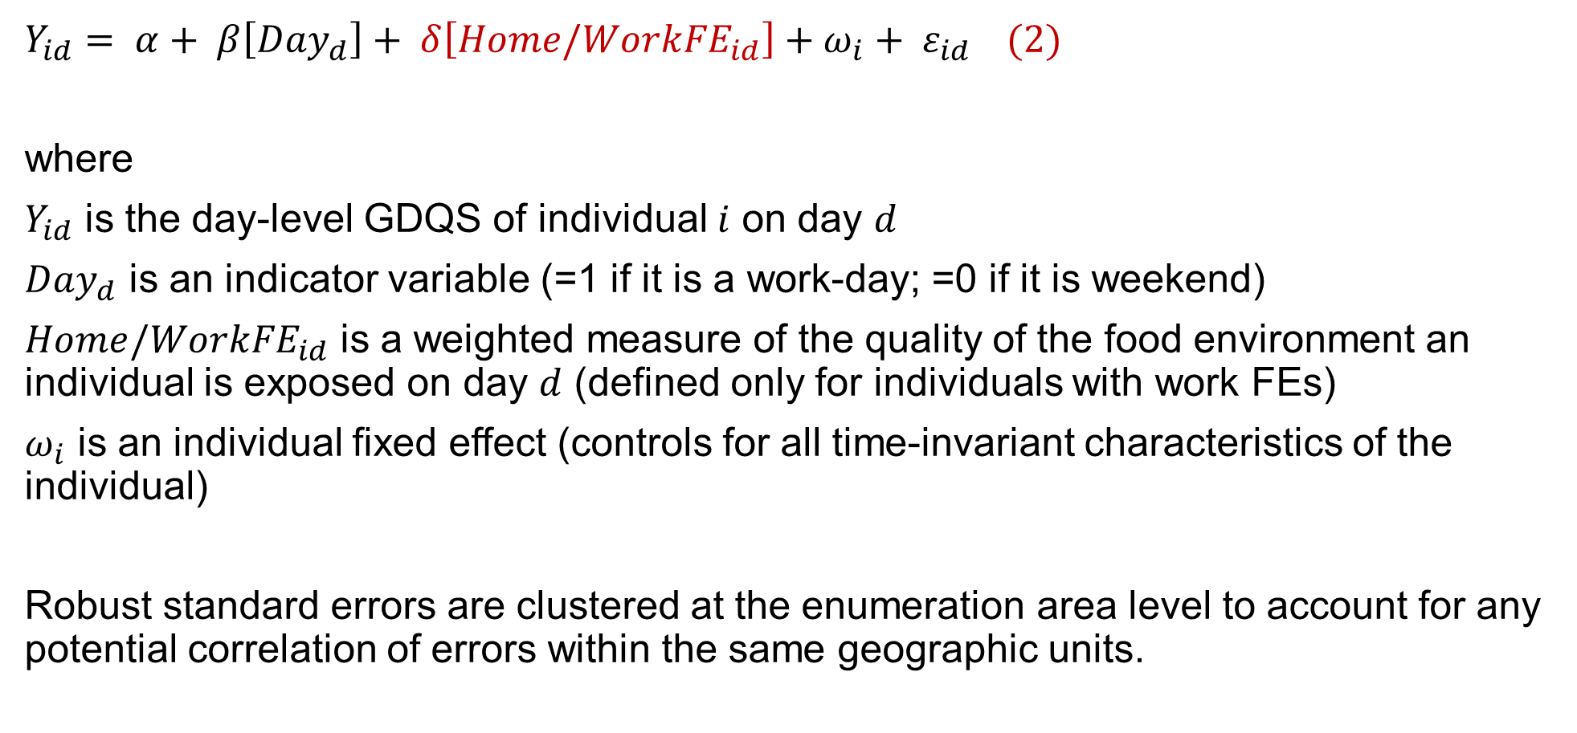
Regression model (Q2)
$Y_{id}= α+ β\left[{Day}_{d}\right]+ δ\left[{Home/WorkFE}_{id}\right]+ω_{i}+ ε_{id}$ (2)
where
$Y_{id}$ is the day-level GDQS of individual $i$ on day $d$
${Day}_{d}$ is an indicator variable (=1 if it is a work-day; =0 if it is weekend)
${Home/WorkFE}_{id}$ is a weighted measure of the quality of the food environment an individual is exposed on day $d$ (defined only for individuals with work FEs)
$ω_{i}$ is an individual fixed effect (controls for all time-invariant characteristics of the individual)
Robust standard errors are clustered at the enumeration area level to account for any potential correlation of errors within the same geographic units.

Slide 34
 | (1) | (2) | (3) | (4)
 | Dependent variable: Day level GDQS
Number of healthy food offer sites per km² | 0.003*
 | (0.002)
Number of unhealthy food offer sites per km² | -0.005**
 | (0.002)
Shelf space devoted to healthy foods (100s m³/km²) |  | 0.008
 |  | (1.069)
Shelf space devoted to unhealthy foods (100s m³/km²) |  | -0.822
 |  | (0.811)
% shelf space in home FE that is healthy |  |  | -0.006
 |  |  | (0.028)
Measure of diversity of healthy foods in home FE |  |  |  | 0.006
 |  |  |  | (0.052)
Measure of diversity of unhealthy foods in home FE |  |  |  | -0.079*
 |  |  |  | (0.043)
Average price of healthy foods (KES/gram) | 0.014 | 0.017* | -0.002 | -0.011
 | (0.009) | (0.009) | (0.012) | (0.018)
Average price of unhealthy foods (KES/gram) | -0.106 | -0.105 | -0.109 | -0.083
 | (0.092) | (0.086) | (0.087) | (0.091)
All controls | Yes | Yes | Yes | Yes
Observations | 1,151 | 1,151 | 1,151 | 1,151
R-squared | 0.034 | 0.014 | 0.002 | 0.013
Healthy food density positively impacts diet quality; while unhealthy food density negatively affects it
Diversity of unhealthy foods exposed in food environment has a negative effect on GDQS
The diversity of healthy foods and shelf space for both do not show significant effects

Slide 35
Key takeaways for influence of FE on diet quality
Does the quality of the home FE explain diet quality?
Yes, we find a significant relationship between home FE quality and diet quality.
  Various careful measures of home FE quality—going beyond the more typical count of outlets—do a good job predicting diet quality.
Does the quality of the FE to which a person is exposed each day (depending on where they spend their time) explain the day-to-day variation in their day-level diet quality?
  Yes, work FEs are important in explaining whether someone eats a relatively healthy diet on a given day (relative to other days).

Slide 36
Implications
Need a multifaceted approach to improving diet quality in urban Kenya
Policies aimed at improving the availability and accessibility of healthy foods in both home and work environments
Targeted interventions in lower-income areas where unhealthy foods currently dominate shelf space
Use of geo-spatial data in policy planning: Leveraging geo-spatial analysis to identify areas with poor FEs and prioritize them for intervention
Gender-sensitive nutritional policies to address specific gender-related dietary behaviors and preferences
Supporting healthier food choices away from home by improving the food options in and around workplaces
  Examples--partnerships with employers to provide healthier food choices in workplace cafeterias

Slide 37
What’s Next?
Refine our analysis
Work FEs
Foods sourced from home vs. work FEs
Explore Machine Learning models to understand heterogenous effects and mediating factors

Slide 38




Acknowledgement of Funding
USAID-Kenya and USDA-FAS through the SARA-KEA project
The Nutrition Center of USAID through the Feed the Future Innovation Lab for Food Security Policy, Capacity, and Influence (PRCI)

Slide 39


Asante sana
Link to the Policy Brief
Questions, Suggestions, Thoughts are Welcome
Contact:
maredia@msu.edu | X: @maredia

Slide 40
Turning to the second topic…

Slide 41
Kenyan farmers’ agricultural and food policy preferences in times of very high fertilizer and food prices vs. normal prices
Mywish K. Maredia¹, John Olwande², Jake Ricker-Gilbert³, David Mather¹, and Nicole Mason¹
¹ Michigan State University
² Tegemeo Institute of Agricultural Policy and Development
³ Purdue University

Slide 42
Motivation
Countries are increasingly confronted by global supply shocks that increase prices for energy, agricultural inputs, and food
Governments often respond to these shocks with policies to mitigate the social and economic impact of high prices

Slide 43
Policy responses to high energy and food prices in 2022
Source: Amaglobeli et al. (2023)

Slide 44
Announced measures in emerging economies (% of count of different measures implemented in 2022)
Several of these measures aim to increase spending on: Subsidies, Cash transfers, Tax relief, vouchers, etc. that generate private goods
Government decisions on the type and scope of these support policies targeted to farmers are often politically motivated or based on misperception of farmer preferences
Source: Amaglobeli et al. (2023)

Slide 45
Motivation (cont’d)
These policies are costly to implement and can be a substantial strain on government budgets
Also, they come at the cost of reduced expd. on long-term, higher-return public goods investments (e.g., R&D, extension, infrastructure)
Thus, it is important to ensure that government policies are effective and responding to the needs of people they aim to benefit

Slide 46
Objectives
We bring to light Kenyan farmers’ perspectives on: How governments should spend its resources to help them cope with the impact of the recent crises that have contributed to high domestic prices of fertilizer and food
To understand if these preferences differ in times of high price shocks vs. times of normal prices

Slide 47

Hypotheses
Farmers’ ordinal preference ranking for how government should spend its budgetary resources in times of crisis are different from how the budget should be spent in normal times
Policies directly benefiting individual farmers, such as subsidies and cash transfers, would rank higher in farmers’ policy preferences during crises
We reject both these hypotheses

Slide 48

Data and Method

Slide 49
Data and Method
We use a hypothetical Best-Worst Scaling (BWS) experiment (Finn and Louviere, 1992, Flynn and Marley, 2014; Lusk and Briggeman, 2009; Maredia et al., 2022)
Data collected through a phone survey conducted between September and October 2023
Sample consists of a random sample of 900 farmers representative of 38 counties in Kenya

Slide 50
Policy options
Type of policy / program | Option name | Policy description (read to respondents)
Social safety net | 1. Cash transfers | Provide cash transfers of up to Ksh 2000 per month for up to 4 months
Subsidies | 2. Farm input subsidies | Increase spending on farm input subsidies
 | 3. Crop & livestock insurance | Increase spending on subsidized crop and livestock insurance
 | 4. Low interest loans | Provide short-term, low interest, unsecured loans
Public good | 5. Market opportunities & price stability | Increase spending on programs that create more market opportunities and price stability for farmers
 | 6. Extension service | Improve public agricultural extension service
 | 7. Roads & bridges in rural areas | Improve roads and bridges in rural areas

Slide 51
BWS design
Sample was randomized into two Module assignments, which differ in the framing of the scenario
Module X: “consider a situation where farmers are facing significantly higher than normal input and food prices similar to the last 12 months.”
Module Y: “consider a situation where farmers are facing normal input and food prices like before COVID 19.”
‘High price scenario’
‘Normal price scenario’

Slide 52
BWS design (cont’d)
The BWS experiment featured seven questions, each presenting three policy options (in randomized order)
Participants were asked to identify their most preferred and least preferred policies among the presented three options
Hypothetical scenario--how government should spend an additional 10% of agricultural budget ‘to help farmers grow more food and increase their incomes and food security.’

Slide 53
“To help farmers grow more food and increase their incomes and food security, government should use the additional money to….”(Read each policy items and select one as most desirable and one as least desirable)
 | Most desirable policy | Least desirable policy
Provide cash transfers of up to Ksh 2000 per month for up to 4 months
Increase spending on programs that create more market opportunities and price stability for farmers
Improve public agricultural extension service

Slide 54
BWS design (cont’d)
Responses to the best-worst questions are utilized to gauge each policy's position on a preference continuum
This approach enables both an ordinal and a cardinal ranking of policy preferences, taking into consideration trade-offs between policies

Slide 55
Empirical strategy
  Best-worst scores
  Mixed Logit (correlated random effects) estimation, and calculation of preference shares for each policy
  Fractional multinomial Logit (FML) model to understand correlates of individual specific share of preferences
  Heterogeneity by sub-groups based on demographic characteristics (Next steps…)

Slide 56
Focus of this presentation
  Best-worst scores
  Mixed Logit (correlated random effects) estimation, and calculation of preference shares for each policy
  Fractional multinomial Logit (FML) model to understand correlates of individual specific share of preferences
  Heterogeneity by sub-groups based on demographic characteristics (Next steps…)

Slide 57

Results

Slide 58
Correlated random parameter logit results
 | Normal price | High price
 | Coef. | Coef.
Farm input subsidies | 1.006* | 1.043*
 | (0.134) | (0.119)
Low interest loans | 1.073* | 1.144*
 | (0.138) | (0.114)
Market opportunities & price stability | 1.434* | 1.618*
 | (0.151) | (0.132)
Subsidized crop and livestock insurance | 0.896* | 0.973*
 | (0.140) | (0.120)
Roads and bridges in rural areas | 1.169* | 1.206*
 | (0.138) | (0.123)
Agricultural extension | 1.355* | 1.395*
 | (0.0144) | (0.129)
Cash transfers (Base) | 0.000 | 0.000
McFadden Psuedo R-squared | 0.106 | 0.103
N | 3150 | 3,150
Log likelihood | -5045.25 | -5065.31
AIC | 10,144 | 10,184
AIC/N | 3.220 | 3.233
BIC | 10,308 | 10,348
Note: Standard Errors are presented in parentheses. Asterisk, ‘*’ , denotes statistical significance at p<0.00001 level

Slide 59
Preference shares and rankings of policies
 | High prices |  |  | Normal times
Rank | Policy | Share |  | Policy | Share
1 | Market opportunities & price stability | 0.229 |  | Market opportunities & price stability | 0.206
2 | Extension service | 0.183 |  | Extension service | 0.190
3 | Roads & bridges in rural areas | 0.152 |  | Roads & bridges in rural areas | 0.158
4 | Low interest loans | 0.143 |  | Low interest loans | 0.143
5 | Farm input subsidies | 0.129 |  | Farm input subsidies | 0.134
6 | Crop & livestock insurance | 0.120 |  | Crop & livestock insurance | 0.120
7 | Cash transfers | 0.045 |  | Cash transfers | 0.049

Slide 60
Kenyan farmers’ policy preferences in…
Strong preference for market-based and public goods investments
Safety net policy least preferred
Ordinal ranking is same
Likes and dislikes are even more pronounced (i.e., change in cardinal ranking)

Slide 61
Main Takeaways
Farmers prefer market-based and public goods options over subsidy-based approaches or safety nets
Farm input subsidies, despite receiving significant government attention and resources, ranked 5th in preference in both scenarios
Policy preference rankings remain consistent regardless of crisis, indicating farmers' ordinal policy preferences are stable
However, the distance between the most and least preferred policies widens during a crisis, suggesting cardinal rankings are sensitive to crisis scenarios
In times of crisis, farmers prioritize market opportunities, price stability, and public goods investments even more, while showing less preference for subsidies and cash transfers

Slide 62
Limitations
Policy options are not exhaustive--Preferences are relative to the seven specific policies included in the experiment
Limitations of a phone survey in reaching farmers that may not own a phone or not reachable due to connectivity issues
Results do not represent preferences of non-crop farmers (e.g., pastoralists, farmers that only do livestock or fishery farming)
Preference rankings presented here are an average across the sample, We have yet to explore heterogeneity in policy preferences by group characteristics that are often targeted by policy makers – e.g., small-holder and resource-poor farmers – this will be the next step

Slide 63
Implications
Massive resources are often invested in mitigation and recovery following an economic crisis
It's crucial to understand if these measures meet the needs of the intended recipients
We show that ‘on average’ across the population of farmers in Kenya, policy responses to high fertilizer and food prices are not aligned with preferences of the intended group
For effective resource allocation, farmers' perspectives must be considered in shaping policy responses both during crises and in normal times

Slide 64
Acknowledgment
Funding supported by: USDA-FAS and USAID-Kenya through the SARA-KEA project

Slide 65
Asante sana
Questions, Suggestions, Thoughts are Welcome
Contact:
maredia@msu.edu | X: @maredia

Slide 66


Slide 67
Descriptive and Balancing Test of Sampled farmers for Module X and Y

